Slide 1
Adjustment of Side Scrolling 2D Horror Game Obstacle From Player Facial Expression Using MoodME Library Unity
Axel Matthew Adiwijaya
219310432
Herman Thuan To Saurik, S.Kom., M.T.
Notes:
Good … Lecturers, and Fellow Students,
My name is Axel Matthew and My Student number is 219310432.
Today, I will present my final project, which is titled ..
Unity WebGL Player | HorrorGame_FearModel (thuanproject.com)
First up is the background of this final projects

Slide 2
BACKGROUND
Sometimes game developers are confused about determining the level of difficulty. Therefore most use static difficulty easy, normal and difficult. By using facial expression, the game created is expected to be able to adapt the difficulty dynamically.
Trying to implement facial emotion detection as an adjustor difficulty based on the player performance.
Notes:
Feel to be challenged to make game and broke stereotype horror must be first person to have that horror feel. Memaksimalkan gambar agar menarik.

Slide 3
GOALS
Successfully utilizes the player's facial expressions to set the game's difficulty level.
Developing existing games so it can adjust the level of difficulty dynamically.
Notes:
Based on the disadvantages, the goals are

Slide 4
SYSTEM ARCHITECTURE

Slide 5
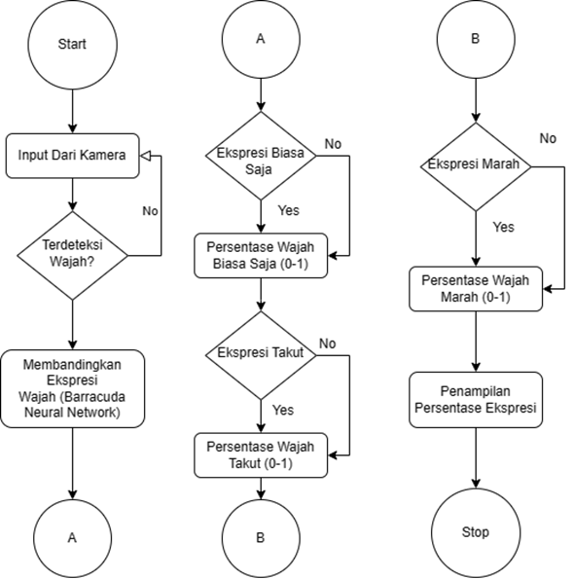
MOODME ARCHITECTURE
Notes:
This is the architecture system for my final projects
Firstly is MoodME architecture
The player face will be detected by using camera, then moodME read the player emotion whether the detected emotion is classified as Normal, Scared or Angry.

Slide 6
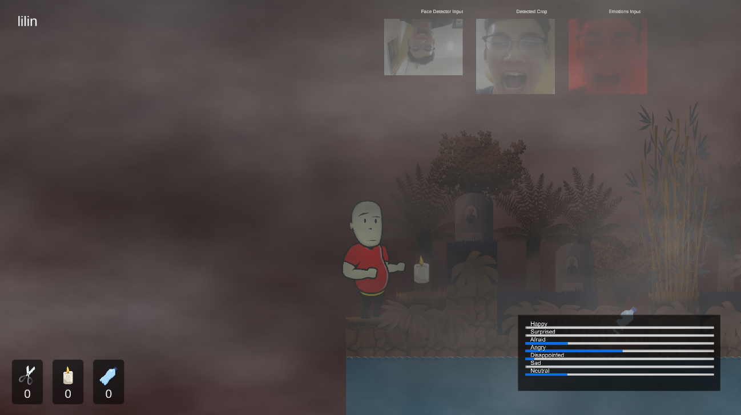
detection of player facial emotion

Slide 7
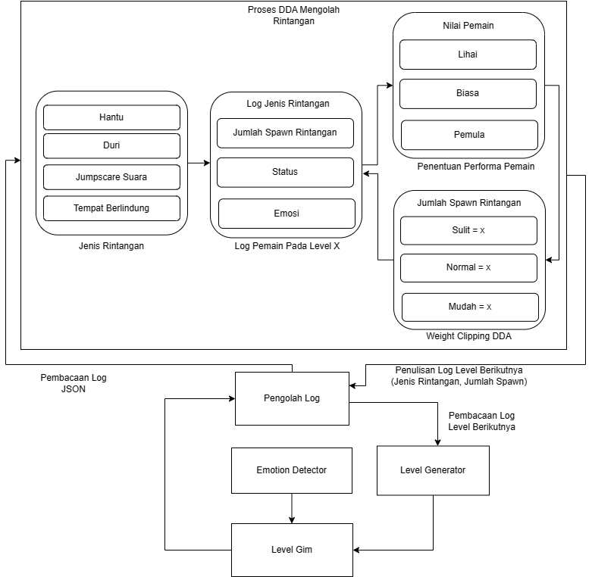
FLOW OF DYNAMIC OBSTACLE ADJUSTER
Notes:
The following is a DDA flow diagram…

Slide 8
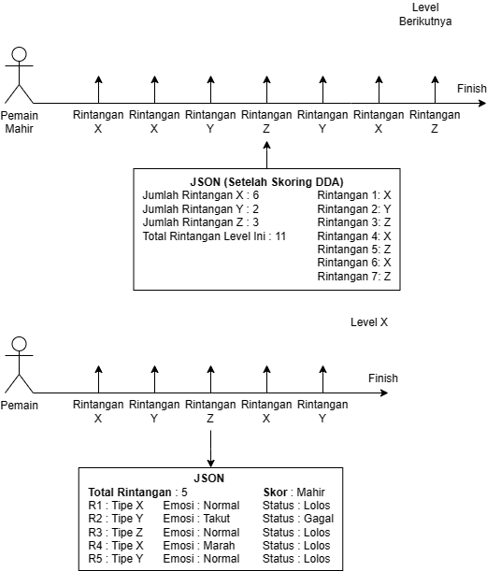
LOGGING SYSTEM
Notes:
The following is the Logging System

Slide 9
PARAMETER CHANGE SIMULATION
Parameter |  |  |  | Emotion Point | DDA Score | Output
Variable | Total | Description | Status |  |  | Decision
JumlahJalanHantu (int) | 4 | Total of the ghost obstacle block on the level | 1,0,0,1 | 2,1,0,0 | Normal (5) | Jumlah = Rand (Weight.Clip Normal)
jumlahJalanJebakan (int) | 4 | Total of the spike obstacle on the level | 1,1,1,1 | 1,1,1,0 | Normal (7) | Jumlah = Rand (Weight.Clip Normal)
Notes:
Dijadikan gambar

Slide 10
LOG
The output will be in the form of a log file (JSON or txt) that records the obstacle type, spawn rate of obstacle, status along with the expression detected after passing it.
The output is read by DDA to determine how much the specific type of obstacle will appear in the next level.

Slide 11
GAMEPLAY

Slide 12
STORY
Gunung Lali Jiwo Arjuno trail, East Java chosen as main scene of the story. Based from mystery news source about hiker who gets separated from the crowd and gets trapped in the middle of the forest which later only found their bones by the rescue team.

Slide 13
GAME MECHANICS
There are 3 level with obstacle which will finished when player survive with some live point.
The map designed with tile map technique, with dynamic content generation that based from DDA data and emotion of the player.
Notes:
PERBAIKI & GANTI INI

Slide 14
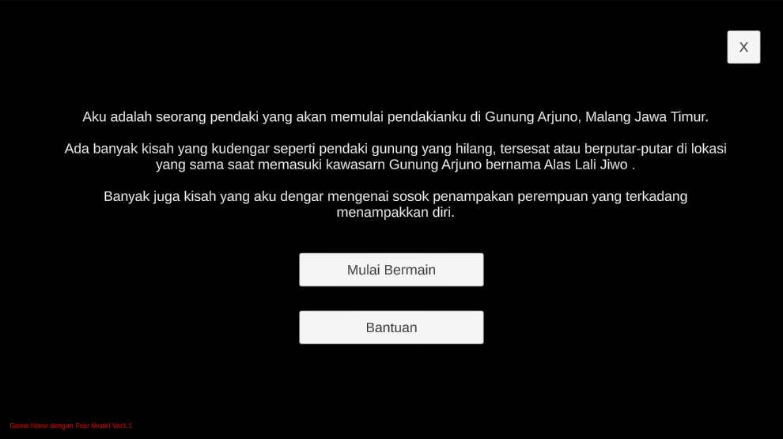
MAIN MENU
Notes:
Player disuguhkan dialog

Slide 15
STAGE OF THE GAME

Slide 16

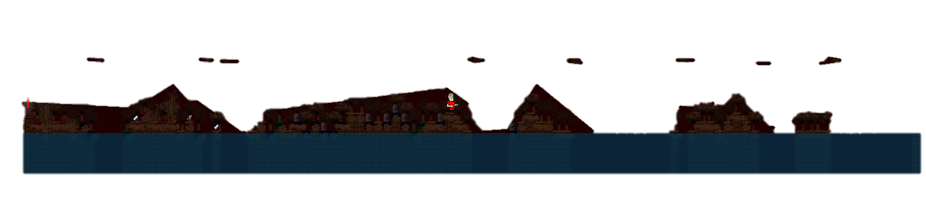
Dynamic Obstacle
Level X
Next Level X

Slide 17
JUMPSCARE

Slide 18
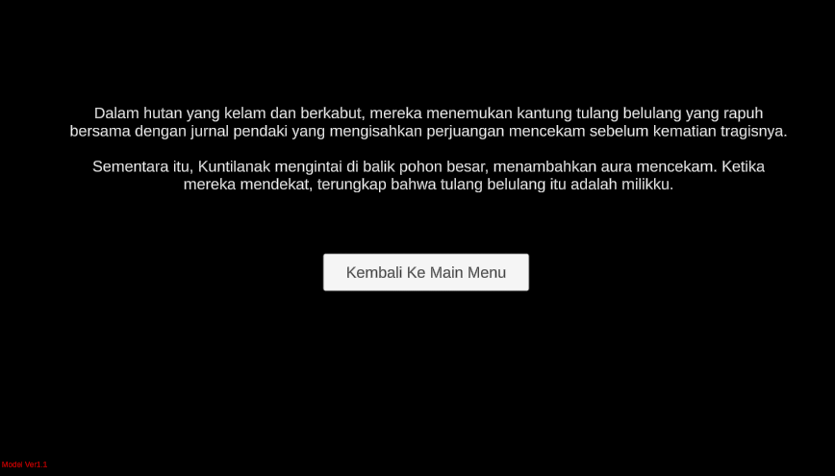
FINISH OF THE GAME

Slide 19
DESIGN

Slide 20
CHARACTER DESIGN
Art style chosen because it resembles real-life graphics, not fully real image & it is my guider signature.
There is research discussing about fear generated by triggering photographic sensory closer to the real-life.
Notes:
Based on the disadvantages, the goals are

Slide 21
Player Movement
Idle
Moving
Swimming

Slide 22



GHOST DESIGN
Front Following Ghost
Screamer Ghost
Normal Ghost

Slide 23
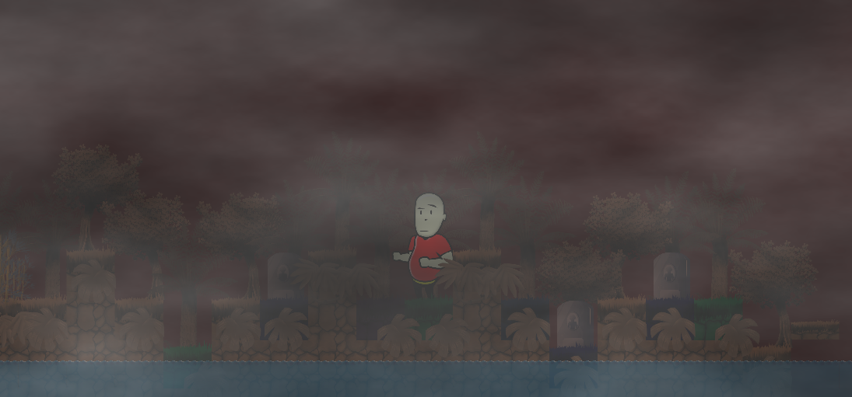
WORLD DESIGN
Tilemap With Content Generator

Slide 24
CONCLUSION

Slide 25
CONCLUSIONS
Prototype created successfully exceed developer expectation to adjust the difficulty of the game.
Most player agree if the DDA used makes the game not monotonous and yet still appealing for another go.
Notes:
Harus nyambung tujuan

Slide 26
FUTURE WORKS
Developing into final game and publish the game after all of the main feature working consistently and finished.

Slide 27
THANKS!
Do you have any questions?

Slide 28
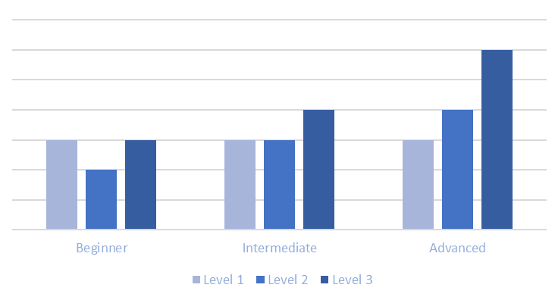
EXPECTED CURVE LEVEL OF DIFFICULTY
Based Of Player Skill

Slide 29
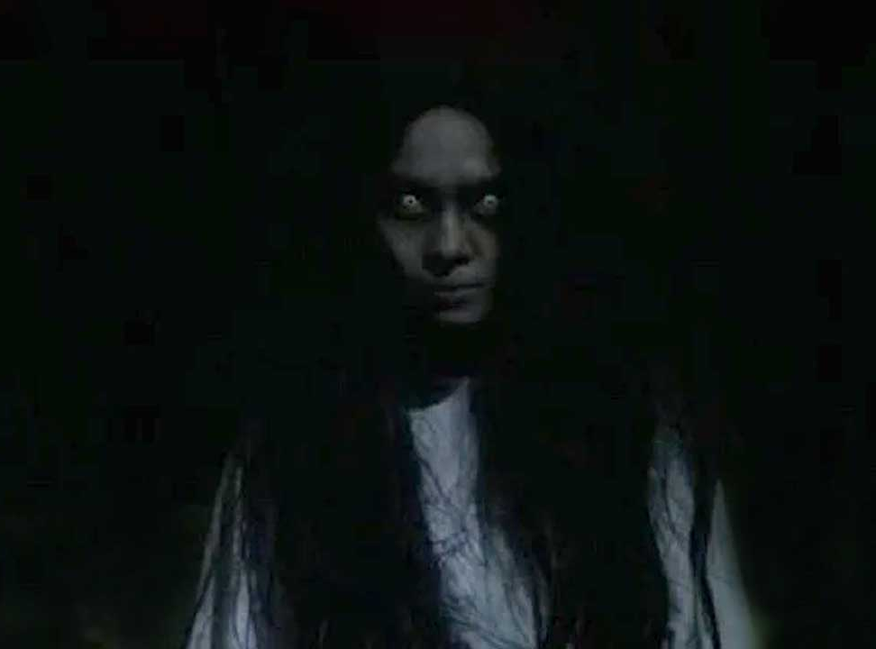
JUMPSCARE (BONUS)

